Slide 1

Through-The-Earth OFDM Communication
Lior Kissos
Supervised by Prof. Moshe Nazarathy
Technion EE Department

Slide 2
Outline
TTE communication
EM principles of the VLF communication
OFDM: a preferred modulation format
System engineering and analog hardware (including OFDM params selection)
Transmitter
Receiver
Experimental results
Conclusions and future directions

Slide 3
TTE Communication

Slide 4
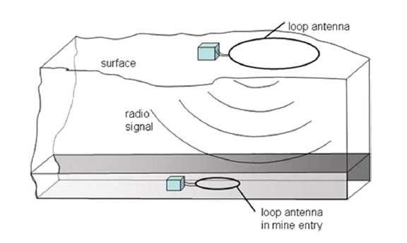
TTE communication

Slide 5
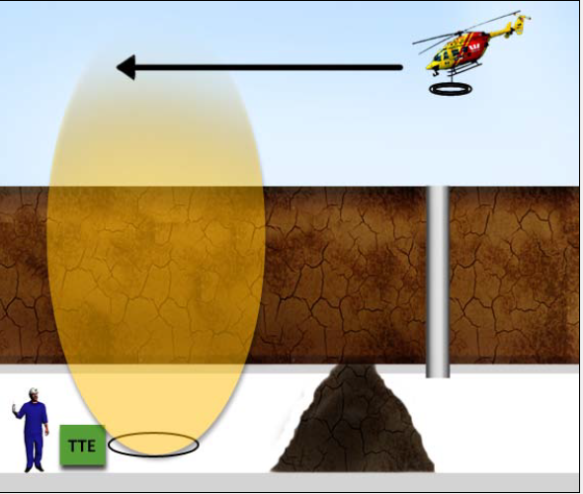
Optional operational deployment

Slide 6
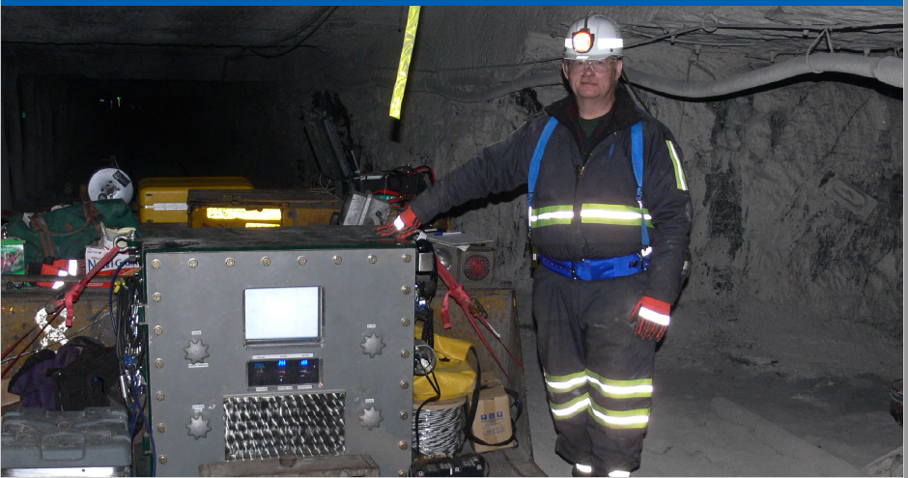
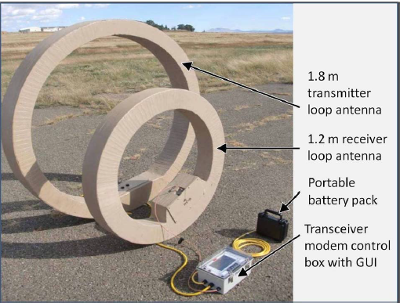
Commercial TTE transceivers: sponsored by the National Institute for Occupational Health (NIOSH)
Lockheed- Martin Inc.
Stolar Inc.

Slide 7
Magneto Quasi Static regime -EM principles

Slide 8
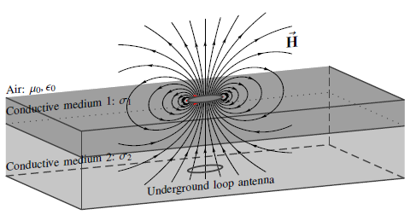
Electro-Magnetic (EM) Considerations
Principal need: Range
Principal challenge: Conducting medium-

Slide 9
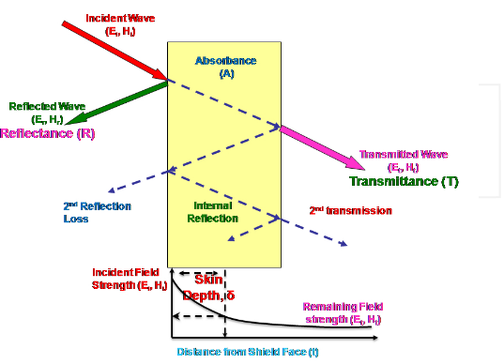
EM Considerations
Challenge: Conducting medium-
reflection
Absorption: Skin Depth
Effects:
Source type
Operating Frequency

Slide 10
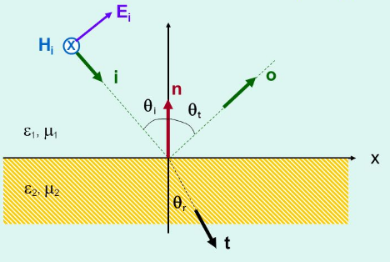
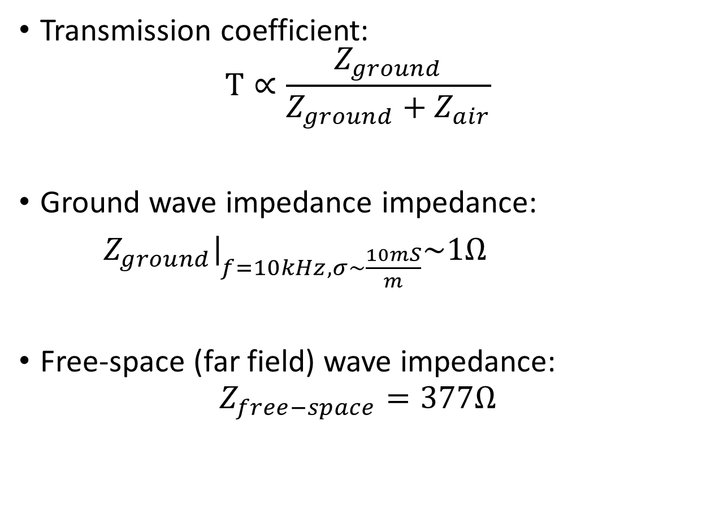
Transmission Coefficient
Transmission coefficient:
$$T∝\frac{Z_{ground}}{Z_{ground}+Z_{air}}$$
Ground wave impedance impedance:
$Z_{ground}{\left.​\right|}_{f=10kHz, σ\sim \frac{10mS}{m}}\sim 1Ω$
Free-space (far field) wave impedance:
$$Z_{free−space}=377Ω$$

Slide 11
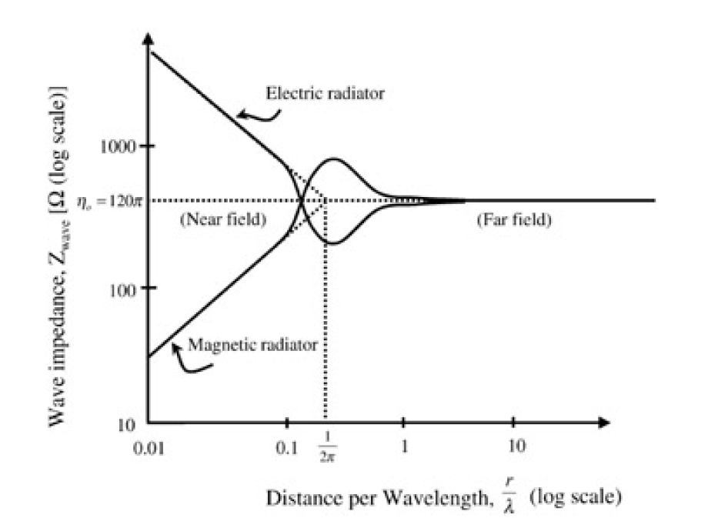
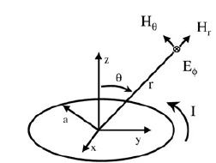
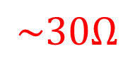
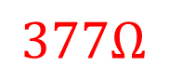
Transmission: Magnetic Vs. Electric Source, the Near Field
Magnetic source
Near field⬄ Very Low Frequency (VLF)
Low impedance wave; H dominance
$$377Ω$$
$$\sim 30Ω$$

Slide 12
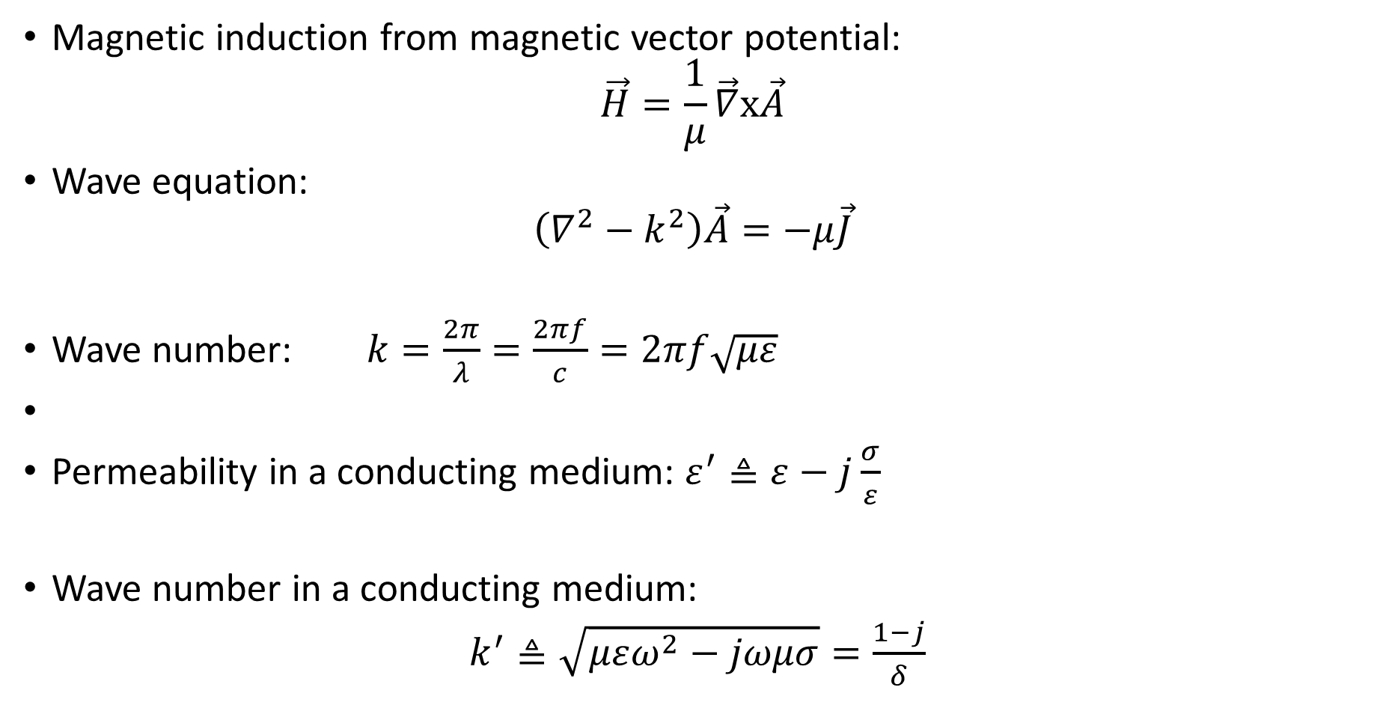
Magnetic Source EM Fields expressions
Magnetic induction from magnetic vector potential:
$$\vec{H}=\frac{1}{μ}\vec{∇}x\vec{A}$$
Wave equation:
$$\left(∇^{2}−k^{2}\right)\vec{A}=−μ\vec{J}$$
Wave number: $k=\frac{2π}{λ}=\frac{2πf}{c}=2πf\sqrt{με}$
Permeability in a conducting medium: $ε^{′}≜ε−j\frac{σ}{ε}$
Wave number in a conducting medium:
$k^{′}≜\sqrt{μεω^{2}−jωμσ}=\frac{1−j}{δ}$

Slide 13
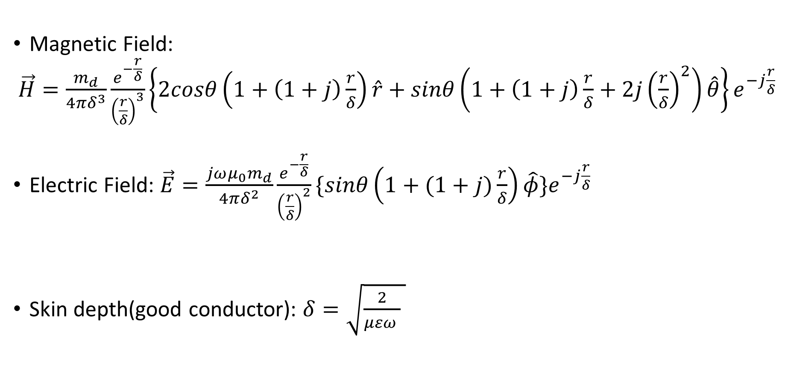
Magnetic Source EM Fields expressions
Magnetic Field:
$\vec{H}=\frac{m_{d}}{4πδ^{3}}\frac{e^{−\frac{r}{δ}}}{{\left(\frac{r}{δ}\right)}^{3}}\left\{2cosθ\left(1+\left(1+j\right)\frac{r}{δ}\right)\hat{r}+sinθ\left(1+\left(1+j\right)\frac{r}{δ}+2j{\left(\frac{r}{δ}\right)}^{2}\right)\hat{θ}\right\}e^{−j\frac{r}{δ}}$
Electric Field: $\vec{E}=\frac{{jωμ_{0}m}_{d}}{4πδ^{2}}\frac{e^{−\frac{r}{δ}}}{{\left(\frac{r}{δ}\right)}^{2}}\{sinθ\left(1+(1+j)\frac{r}{δ}\right)\hat{φ}\}e^{−j\frac{r}{δ}}$
Skin depth(good conductor): $δ=\sqrt{\frac{2}{μεω } }$

Slide 14
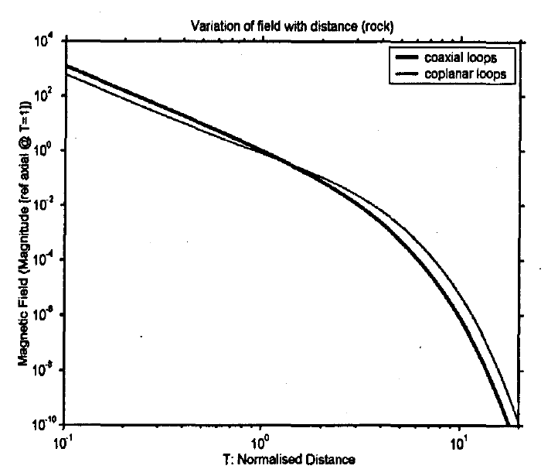
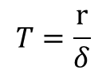
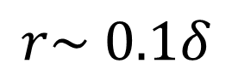
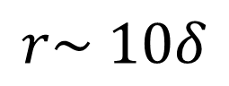
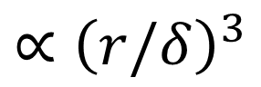
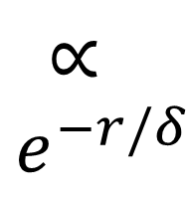
Fields within conducting medium: the Magneto Quasi static zone and the square cube behavior
Square cube-
Wanted!
$${∝\left(r/δ\right)}^{3}$$
$$∝$$
$$e^{−r/δ}$$
Quasi
Static
zone
Far Field
zone
Near Field zone
$$r\sim 0.1δ$$
$$r\sim 10δ$$
$$T=\frac{r}{δ}$$

Slide 15
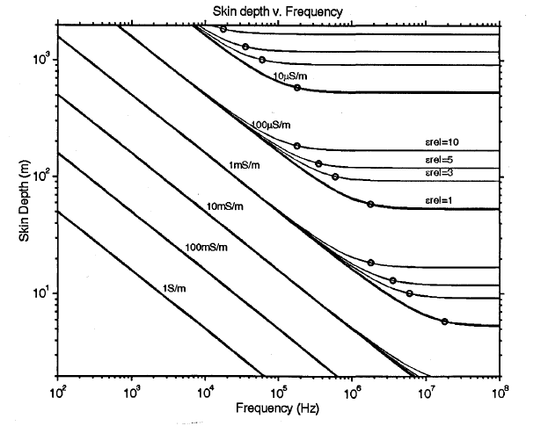
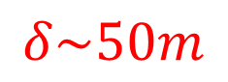
Fields within conducting medium: the Skin Depth
$$δ\sim 50m$$
Notes:
10kHz measurement ; valid for all epsilons

Slide 16
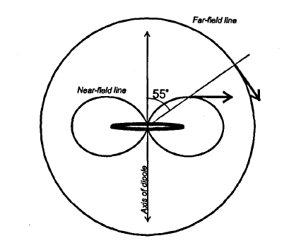
Antennas: Near/Far Field lines
$$\vec{H}=\frac{m_{d}}{4πδ^{3}}\frac{e^{−\frac{r}{δ}}}{{\left(\frac{r}{δ}\right)}^{3}}\left\{2cosθ\left(1+\left(1+j\right)\frac{r}{δ}\right)\hat{r}+sinθ\left(1+\left(1+j\right)\frac{r}{δ}+2j{\left(\frac{r}{δ}\right)}^{2}\right)\hat{θ}\right\}e^{−j\frac{r}{δ}}$$

Slide 17
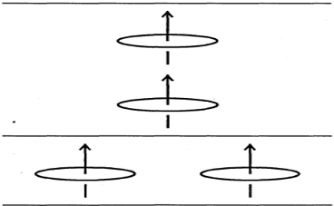
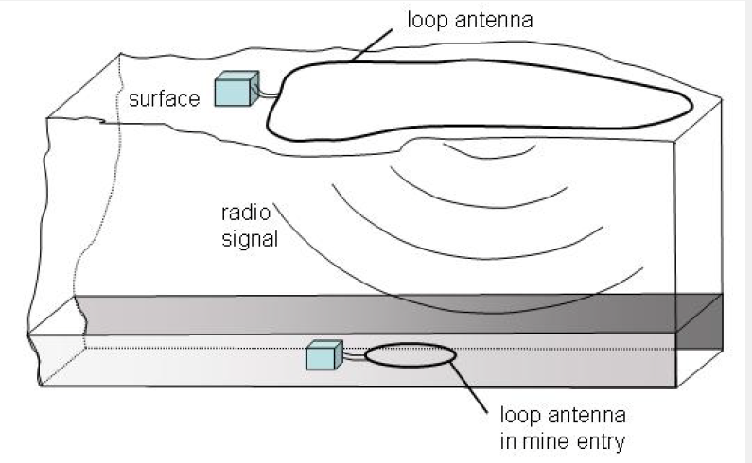
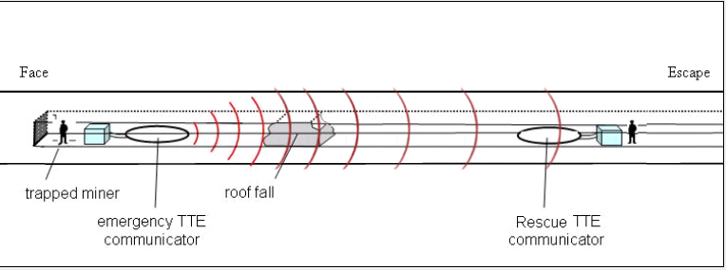
Antennas: possible mutual Orientations

Slide 18
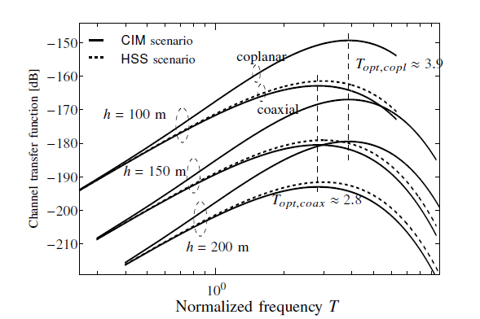
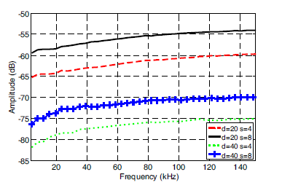
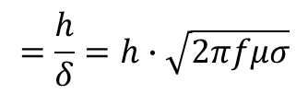
Selectivity (Frequency dependence): VLF channel
Theoretical
Experimental
$$=\frac{h}{δ}=h∙\sqrt{2πfμσ}$$
Frequency non-flat channel => Channel with memory!

Slide 19
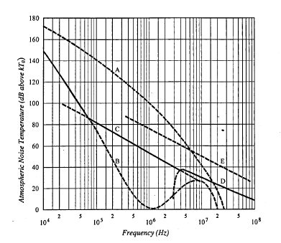
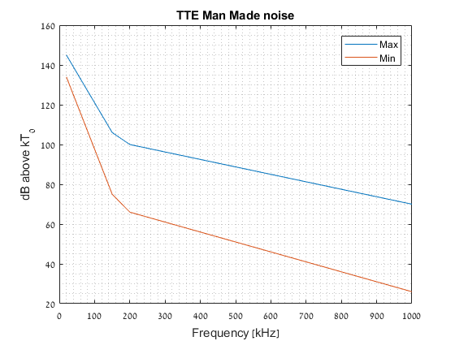
Selectivity: VLF Noise
Atmospheric
Man- made

Slide 20
Technique choice: Considerations
Channel & Noise Models:
Unreliable
Out of date (man made noise)
Certainty: frequency selective!
Literature & Commercial system:
Digital single carrier transmission
Fixed stations: channel, mutual antenna orientation and noise well known
Poor performance wrt expected (NIOSH)
Our objective: Deployable moving stations-
Variable antenna orientations
Variable channel
Variable noise

Slide 21
OFDM- A preferred communication technique

Slide 22
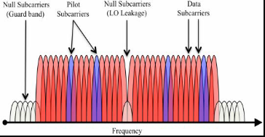
OFDM in the TTE context
Principle: Parallel instead of serial
Selective& Dynamic Channel & Noise:
Rx:
Easy equalization
Easy adaptation to varying length channels
Tx:
frequency selective power, modulation and coding
Dynamic Antenna orientation:
OFDM& MIMO Maximum Ratio Combining (MRC)

Slide 23
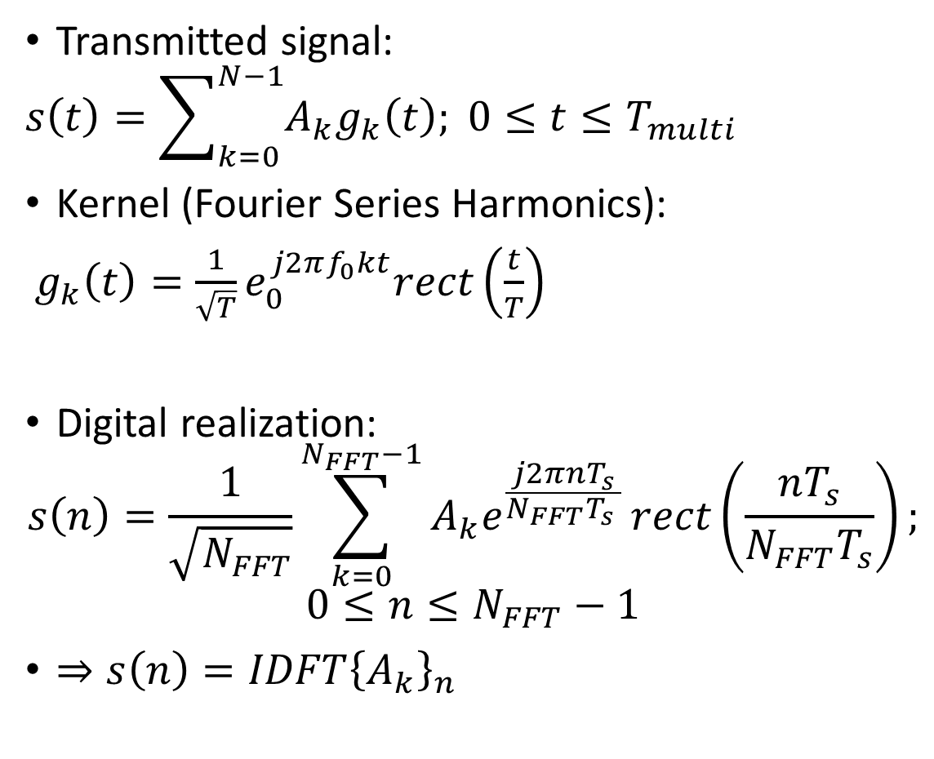
OFDM Transmission
Transmitted signal:
$$s\left(t\right)=\sum_{k=0}^{N−1}{A_{k}g_{k}\left(t\right); 0≤t≤T_{multi}}$$
Kernel (Fourier Series Harmonics):
$g_{k}\left(t\right)=\frac{1}{\sqrt{T}}e_{0}^{j2πf_{0}kt}rect\left(\frac{t}{T}\right)$
Digital realization:
$$s\left(n\right)=\frac{1}{\sqrt{N_{FFT}}}\sum_{k=0}^{N_{FFT}−1}{A_{k}e^{\frac{j2πnT_{s}}{N_{FFT}T_{s }}}}rect\left(\frac{nT_{s}}{N_{FFT}T_{s}}\right);$$
$$0≤n≤N_{FFT}−1$$
$⇒s\left(n\right)=IDFT{\left\{A_{k}\right\}}_{n}$

Slide 24
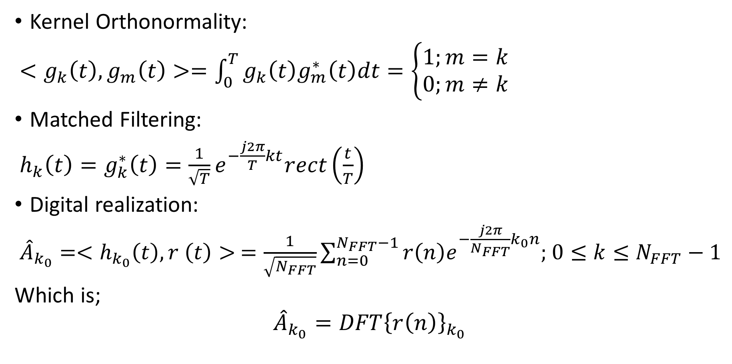
OFDM Reception
Kernel Orthonormality:
$<g_{k}\left(t\right),g_{m}\left(t\right)>=\int_{0}^{T}{g_{k}\left(t\right)g_{m}^{∗}\left(t\right)dt}=\left\{\begin{aligned}&1;m=k \\ &0;m≠k\end{aligned}\right.$
Matched Filtering:
$h_{k}\left(t\right)=g_{k}^{∗}\left(t\right)=\frac{1}{\sqrt{T}}e^{−\frac{j2π}{T}kt}rect\left(\frac{t}{T}\right)$
Digital realization:
${\hat{A}}_{k_{0}}=<h_{k_{0}}\left(t\right),r \left(t\right)> =\frac{1}{\sqrt{N_{FFT}}}\sum_{n=0}^{N_{FFT}−1}{r\left(n\right)e^{−\frac{j2π}{N_{FFT}}k_{0}n};}$ $0≤k≤N_{FFT}−1$
Which is;
$${\hat{A}}_{k_{0}}=DFT{\left\{r\left(n\right)\right\}}_{k_{0}}$$

Slide 25
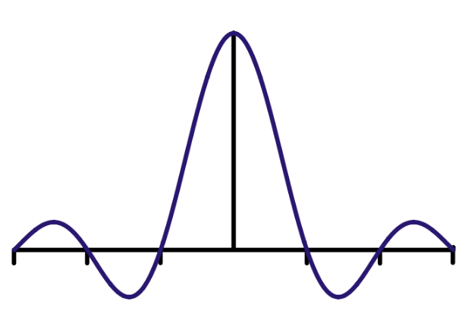
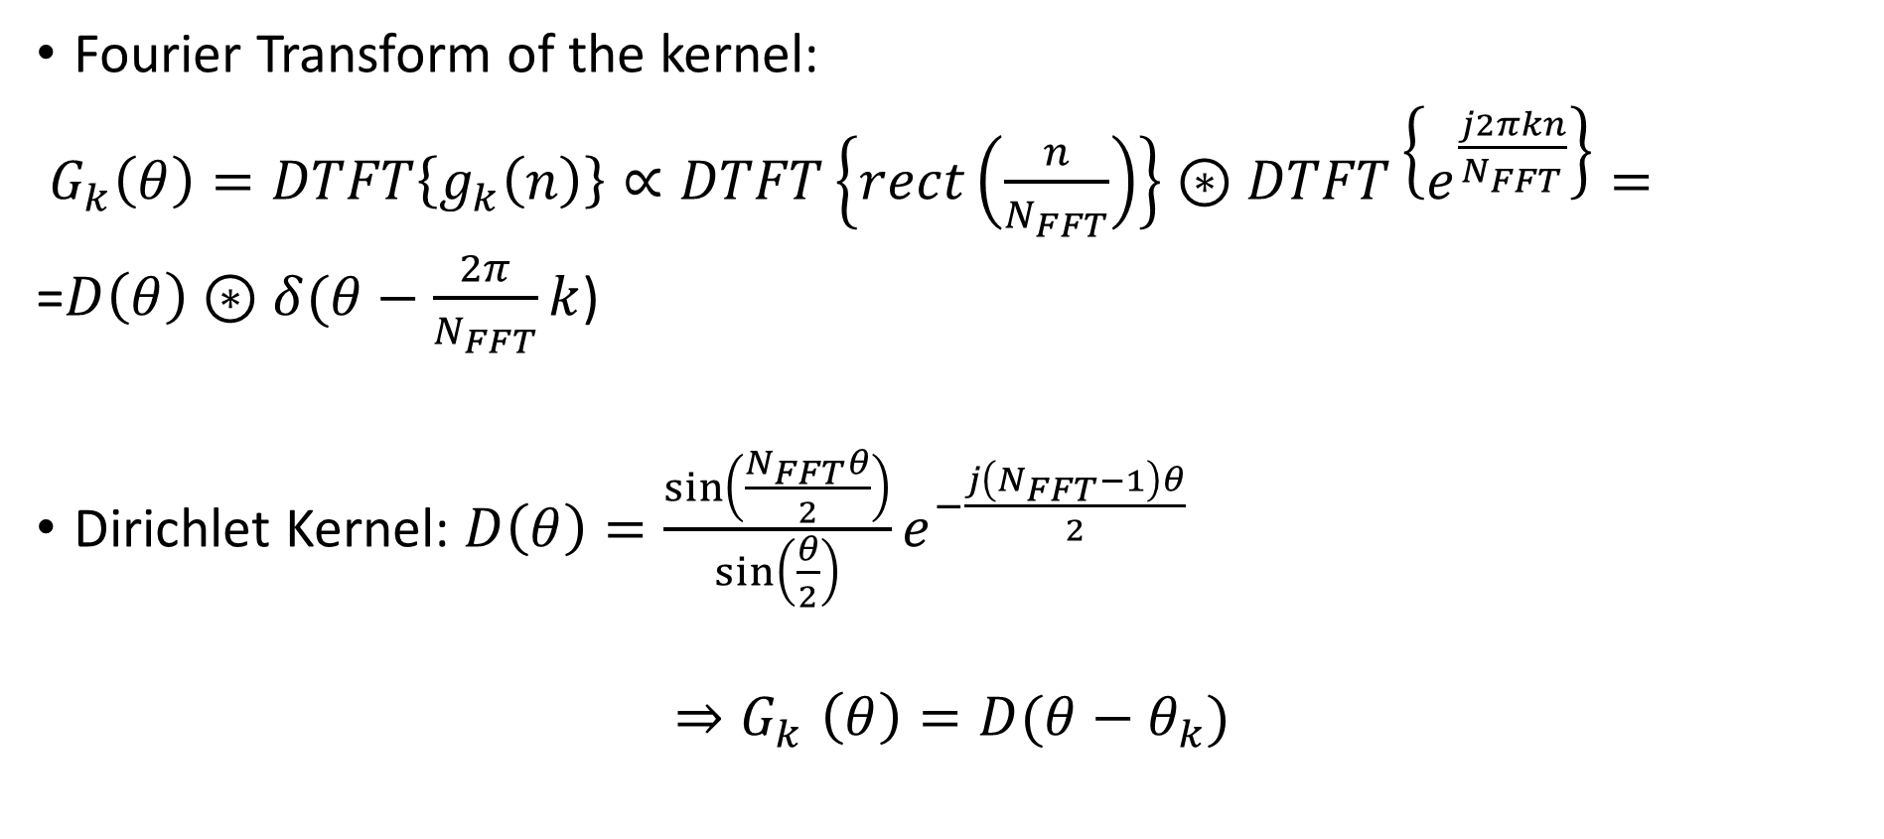
OFDM: Frequency Domain
Fourier Transform of the kernel:
$G_{k}\left(θ\right)=DTFT\left\{g_{k}\left(n\right)\right\}∝DTFT\left\{rect\left(\frac{n}{N_{FFT}}\right)\right\}⊛DTFT\left\{e^{\frac{j2πkn}{N_{FFT}}}\right\}=$
=$D\left(θ\right)⊛δ(θ−\frac{2π}{N_{FFT}}k$)
Dirichlet Kernel: $D\left(θ\right)=\frac{\sin\left(\frac{N_{FFT}θ}{2}\right)}{\sin\left(\frac{θ}{2}\right)}e^{−\frac{j\left(N_{FFT}−1\right)θ}{2}}$
$${⇒G}_{k}\left(θ\right)=D(θ−θ_{k})$$

Slide 26
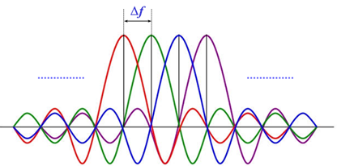
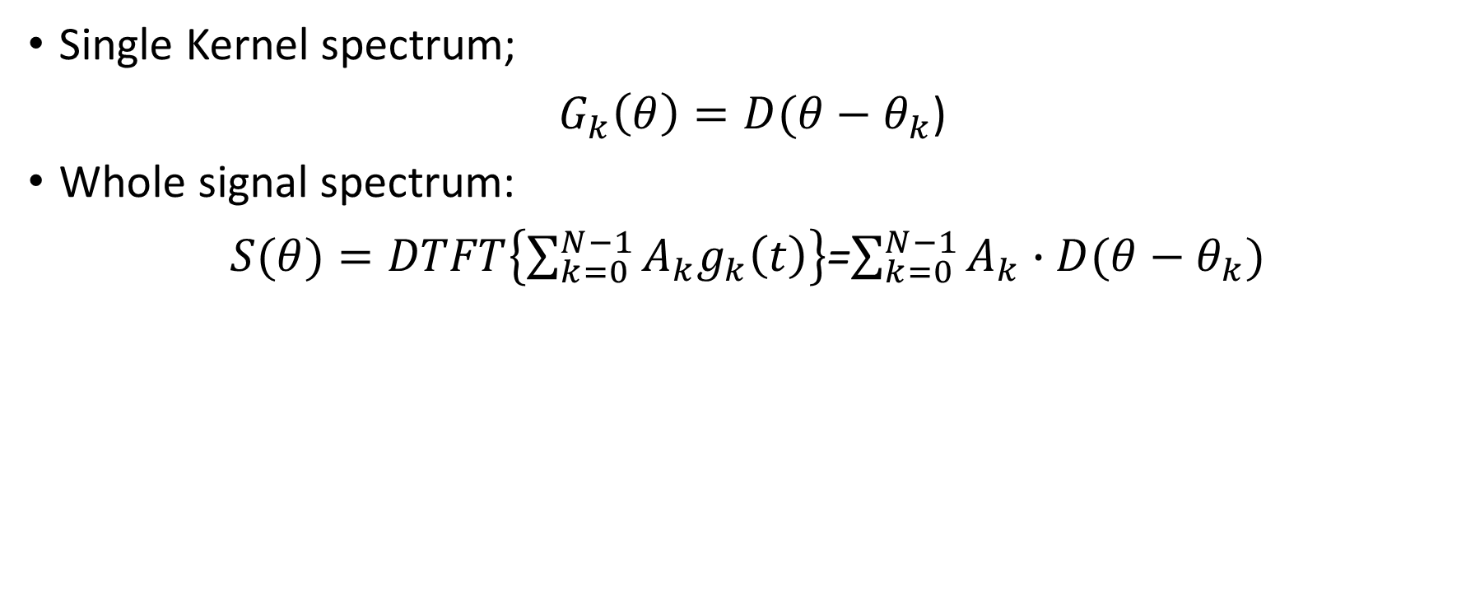
OFDM: Frequency Domain
Single Kernel spectrum;
$G_{k}\left(θ\right)=D(θ−θ_{k}$)
Whole signal spectrum:
$S(θ)=DTFT\left\{\sum_{k=0}^{N−1}{A_{k}g_{k}\left(t\right)}\right\}$=$\sum_{k=0}^{N−1}{A_{k}∙D(θ−θ_{k})}$
subcarrier

Slide 27
OFDM: frequency domain- special subcarriers
1)Channel est.
2) Freq synch
1)DSP alleviation
2) ACPR prevention

Slide 28
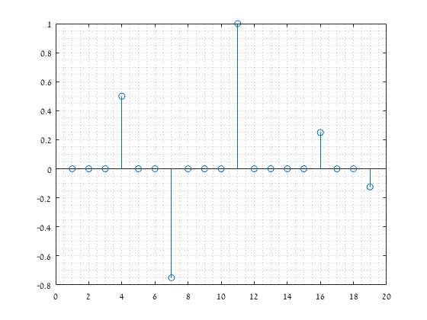
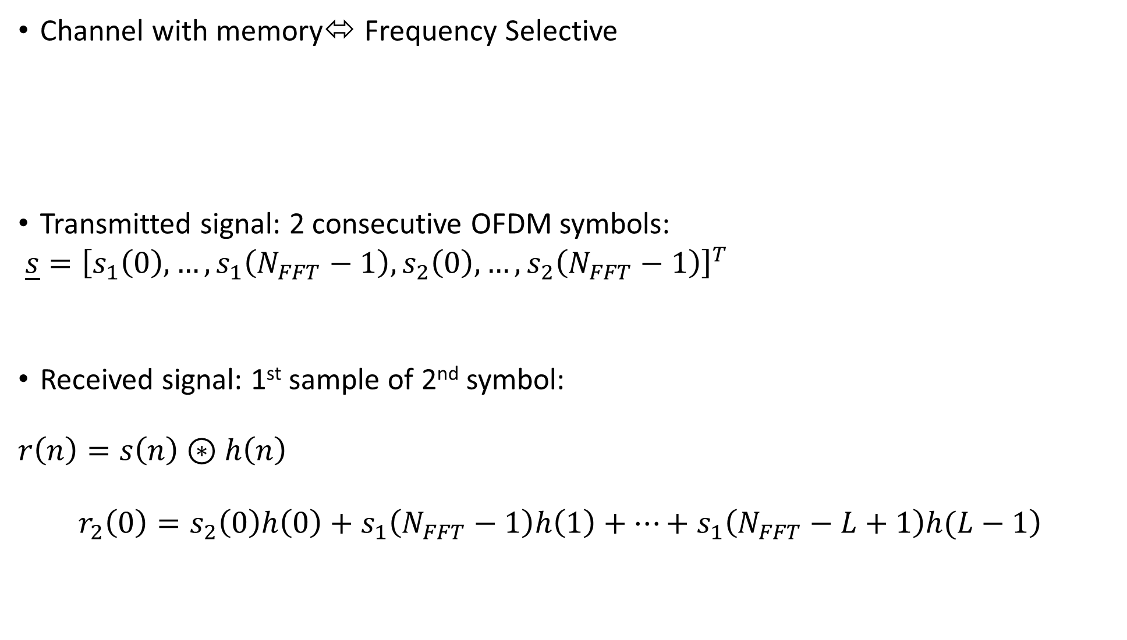
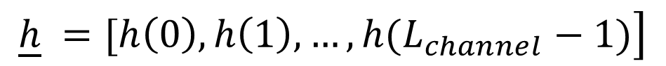
OFDM: Time Domain- Cyclic Prefix( ISI )
Channel with memory⬄ Frequency Selective
Transmitted signal: 2 consecutive OFDM symbols:
$\underline{s}={\left[s_{1}\left(0\right),…,s_{1}\left(N_{FFT}−1\right),s_{2}\left(0\right),…,s_{2}\left(N_{FFT}−1\right)\right]}^{T}$
Received signal: 1st sample of 2nd symbol:
$$r\left(n\right)=s\left(n\right)⊛h\left(n\right)$$
$$\left.r_{2}\left(0\right)=s_{2}\left(0\right)h\left(0\right)+s_{1}\left(N_{FFT}−1\right)h\left(1\right)+…+s_{1}\left(N_{FFT}−L+1\right)h(L−1\right)$$
$$\left.\underline{h} =[h\left(0\right),h\left(1\right),…,h(L_{channel}−1)\right]$$
ISI

Slide 29
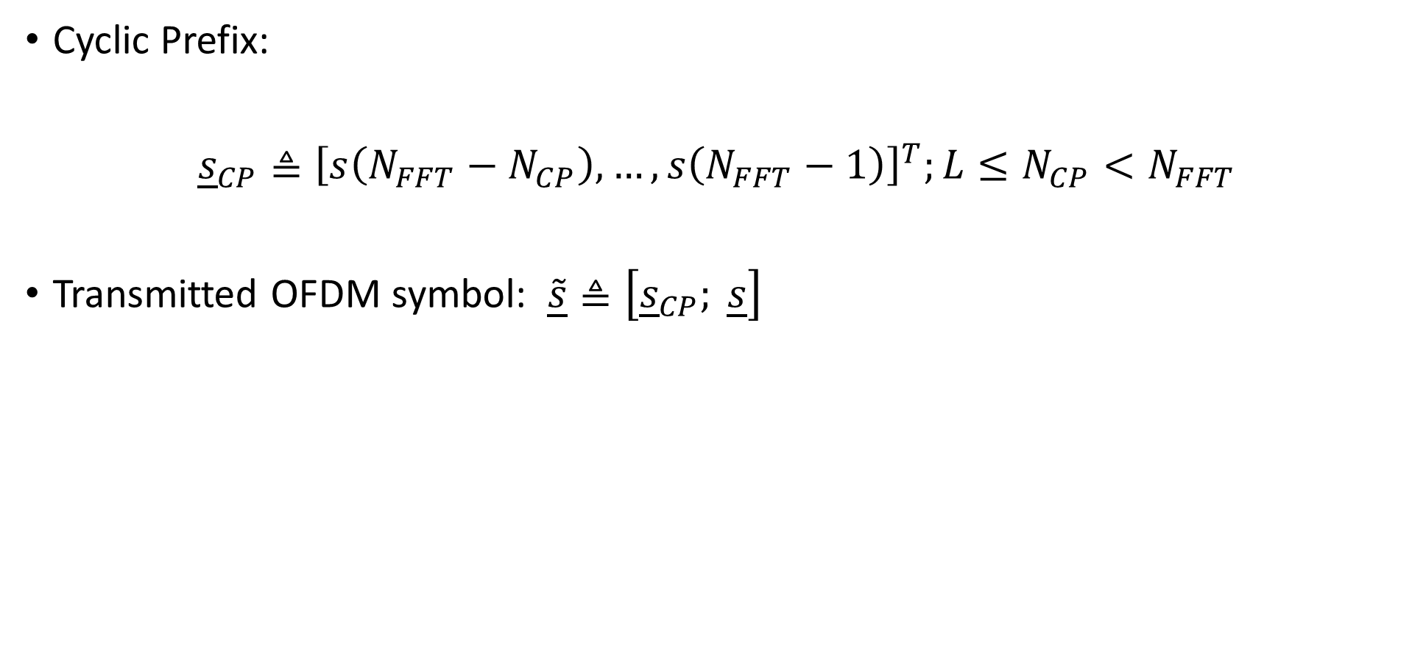
OFDM: Time Domain- Cyclic Prefix( ISI )
Cyclic Prefix:
${\underline{s}}_{CP}≜{\left[s\left(N_{FFT}−N_{CP}\right),…,s\left(N_{FFT}−1\right)\right]}^{T};{L≤N}_{CP}<N_{FFT}$
Transmitted OFDM symbol: $\underline{\tilde{s}}≜\left[{\underline{s}}_{CP}; \underline{s}\right]$
Cyclic Prefix

Slide 30
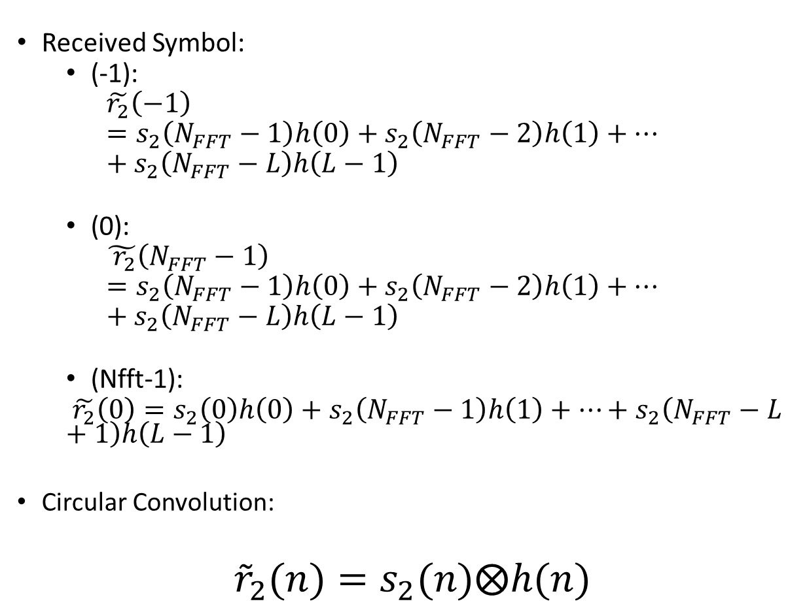
OFDM: Time Domain- Cyclic Prefix( ISI )
Received Symbol:
(-1):
$$\tilde{r_{2}}\left(−1\right)=s_{2}\left(N_{FFT}−1\right)h\left(0\right)+s_{2}\left(N_{FFT}−2\right)h\left(1\right)+…+s_{2}\left(N_{FFT}−L\right)h\left(L−1\right)$$
(0):
$$\tilde{{ r}_{2}}\left(N_{FFT}−1\right)=s_{2}\left(N_{FFT}−1\right)h\left(0\right)+s_{2}\left(N_{FFT}−2\right)h\left(1\right)+…+s_{2}\left(N_{FFT}−L\right)h\left(L−1\right)$$
(Nfft-1):
$\tilde{r_{2}}\left(0\right)=s_{2}\left(0\right)h\left(0\right)+s_{2}\left(N_{FFT}−1\right)h\left(1\right)+…+s_{2}\left(N_{FFT}−L+1\right)h\left(L−1\right)$
Circular Convolution:
${\tilde{r}}_{2}(n)=s_{2}(n)⨂h(n)$

Slide 31
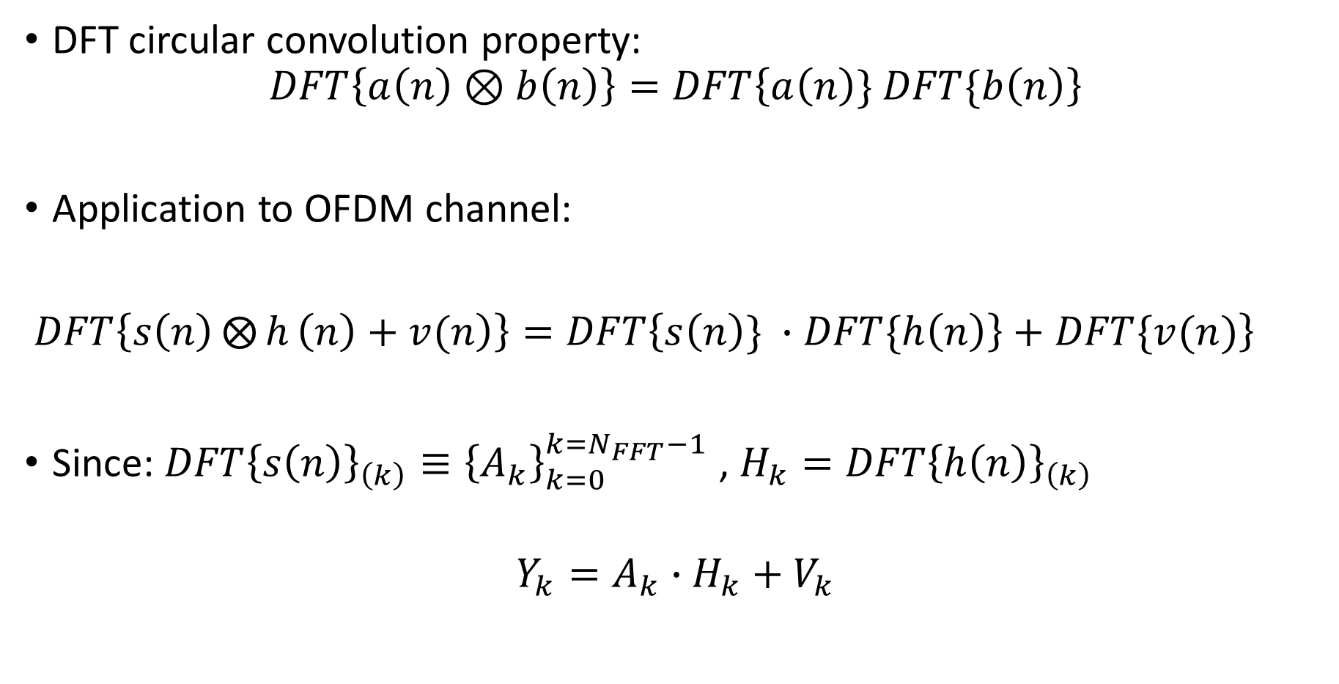
Frequency domain Equalization
DFT circular convolution property:
$$DFT\left\{a\left(n\right)⊗b\left(n\right)\right\}=DFT\left\{a\left(n\right)\} DFT\{b\left(n\right)\right\}$$
Application to OFDM channel:
$\left.DFT\left\{\left.s\left(n\right)⨂{h}\left(n\right)+v(n\right)\right\}=DFT\left\{s\left(n\right)\} ∙DFT\{h\left(n\right)\right\}+DFT\{v(n)\right\}$
Since: $DFT{\left\{s\left(n\right)\right\}}_{\left(k\right)}≡{\left\{A_{k}\right\}}_{k=0}^{k=N_{FFT}−1}$ , $H_{k}=DFT{\left\{h\left(n\right)\right\}}_{\left(k\right)}$
$$Y_{k}=A_{k}∙H_{k}+V_{k}$$

Slide 32
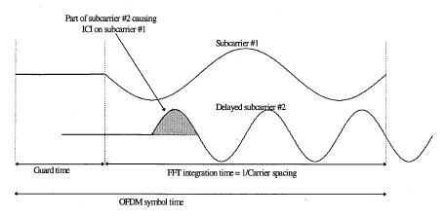
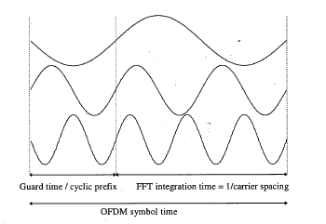
Cyclic Prefix: Inter Carrier Interference (ICI)
Dispersion: non- integer number of cycles over interval
Loss of orthogonality
Inter carrier interference!
Cyclic prefix extension: regaining integer number of cycles

Slide 33
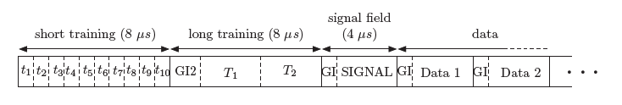
OFDM: Time Domain- OFDM Packet
Data
Training Preamles
(synchronization,
Channel estimation)
CP
Data

Slide 34
System Engineering

Slide 35
Link
BW (=Fchip)=10kHz
Fif=10kHz
Frec=100ksps
Tx
OFDM
Tx
IF
D/A
&
Rec. Filter
Channel
A/D
&
AA Filter
Rx
IF
Rx
OFDM
Fs=100ksps

Slide 36
Concepts: Software Defined Radio (SDR)
Transmitter:
Receiver:
Fully Digital

Slide 37
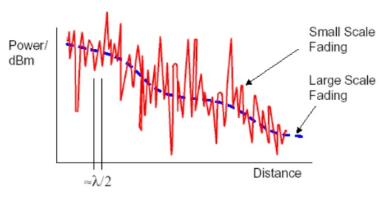
Concepts: Single Input Multiple Output (SIMO) 1x3- wireless channel (in Far Field)
Random
Determinitic:
Distance
Antenna orientation

Slide 38
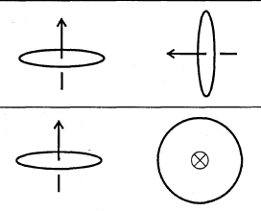
Concepts: SIMO 1x3- Large Scale Fading
Good coupling
Poor coupling (ideally null)

Slide 39
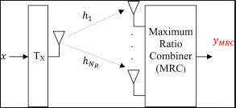


Concepts: SIMO 1x3- Diversity
angular
spatial

Slide 40





Tx Chain
D/A
Tx
OFDM
Tx
IF
Coil
Amplifier

Slide 41


Rx Chain
Sensor
A/D
Tx
OFDM
Tx
IF

Slide 42
Analog Hardware

Slide 43



Analog Hardware- Transmitter
D/A: NI USB6212
# of bits =16
Fs,max=250ksps
Vout,max=+/-10v
Amplifier: AE Techron 2105
Amplification, max=20V/V
Frequency range=[0,20]kHz
Vout,max=150 v
Zout=28mOhm in series with 1uH
Antenna: FESP-5133 1330
Diameter=0.126m
# of windings=225
Inductance= 6.5 mH
Frequency range= [0,20]kHz
Saturation current= 20 Amps

Slide 44

Analog Hardware- Receiver
A/D: NI USB6212
# of inputs=4
# of bits=16
Fs,max=100 ksps
Vin,max=+/-10v
Anti Aliasing Filter: MAX7418 (not used finally)

Slide 45



Analog Hardware- Receiver
3-axis active Antenna: Metronix SHFT-02e
Frequency range=[1,300]kHz
Output Sensitivity= 0.05V/nTesla

Slide 46
System predicted Performance

Slide 47


Link Budget- System parameters
Signal:
$Fc=10kHz$
$BW=10kHz$
$PAPR=12dB$
Tx coil:
$induction=L=485μH$
$Diameter=D=0.5m$
$\# of windings=N_{coil}=20$
Tx amplifier:
$V_{in},\max{=+/−10V}$ (that is also the D/A’s full scale voltage)
$G=amplification=20 [V/V]$
Rx Sensor:
$Sensitivity=0.05\left[\frac{V}{nT}\right]$
$Noise spectral density=$
$$8e−15[Tesla/\sqrt{Hz}]$$
A/D:
$ENoB=12.5$
$F_{s}=100Ksps$
$V_{FS}=10V$
Channel:
Free space
$range=1[m]$

Slide 48

Link Budget: Calculation - Signal
Tx:
D/A: $V_{DAC out,RMS}=V_{FS}{∙10}^{−\frac{PAPR[dB]}{20}}=2.5 V$
Amplifier: $V_{Amp out, RMS}=V_{DAC out,RMS}G_{Amp}=2.5∙20=50.2 V$
Antenna:
$B\left(r,f\right)=μ\frac{π{\left(\frac{D}{2}\right)}^{2}\left(\frac{V_{Amp out, RMS}}{Z_{coil}}\right)N_{coil}}{2πr^{3}}=4.7e−7\frac{pi{\left(\frac{0.125}{2}\right)}^{2}\left(\frac{50.2}{408}\right)225}{2π{∙1}^{3}}=6.8e−8 [Tesla]$
Rx:
Antenna:
$V_{sensor, out}\left(r,f\right)=B\left(r,f\right)\left[Tesla\right]∙Sensitivity\left[\frac{V}{Tesla}\right]=6.8e−8∙0.05e9=3.39 V$
$P_{sensor, out}=10\log_{10}{(\frac{V_{sensor,out}^{2}}{50})}=23.6 dBm$ (effective over 50 ohm load)

Slide 49

Link Budget- Calculation: Noises
Channel: $N_{VLF}=−174\left[\frac{dBm}{Hz}\right]+125\left[dB\right]10\log_{10}{BW}=−9[dBm]$
Rx Antenna (Sensor):
${NSD}_{sensor}=8e−15\left[\frac{Tesla}{\sqrt{Hz}}\right]∙0.05e9\left(\frac{V}{Tesla}\right)=4e−7\left[\frac{V}{\sqrt{Hz}}\right]$
$V_{SQR,sensor}[V^{2}]=NSD_{sensor}^{2}\left[\frac{V^{2}}{Hz}\right]∙BW\left[Hz\right]$
$N_{sensor}=10\log_{10}{(V_{SQR,sensor}}/50)=−75dBm$ (effectively referred to 50 Ohm)
A/D:
$DR=ENoB⋅6+1.76=12.5∙6+1.76=76.7dB$
$P_{FS}=10\log_{10}{(V_{FS}^{2}/(2∙50))}=10\log_{10}{({10}^{2}/(2∙50))}=30dBm$
$N_{ADC}={(P}_{FS}−DR)−10\log_{10}{\frac{F_{s}}{BW}}=(30−76.7)−10\log_{10}{\frac{100k}{10k}}=−56.7dBm$
Conclusion: Channel noise is dominant

Slide 50



Link Budget- Preliminary experiment
Magnetic devices
Tx chain:
Rx chain:

Slide 51
Link Budget- Preliminary experiment: Results

Slide 52

Theory Vs. Experimental: at A/D output
SNR ( SNR~EVM in this waveform parameters):
Theory: $33dB$
Experiment: $41dB$
Signal:
Theory: $23.6dBm$
Experiment: $31dBm$
$SNR_{hyb}≜\frac{P_{RX,exp}}{N_{Rx,th}}=40 dB↔EVM\sim 40dB!$
Conclusion: at 3 meters (1 floor): $EVM\sim 14dB$

Slide 53

Throughput
$Throughput\left[\frac{data bits}{sec}\right]=\frac{Data bits per packet}{Packet Duration}$
$Data bits per packet\left[\frac{data bits}{packet}\right]=Data Symbols\left[\frac{OFDM sym}{packet}\right]$
$$∙Data subcarriers\left[\frac{QAM data sym}{OFDM sym}\right]$$
$$∙Modulation[\frac{bits}{QAM sym}]∙code rate[\frac{data bits}{coded bits}]$$

Slide 54

Throughput
$$Packet Duration\left[sec\right]=$$
$$T_{chip}\left[N_{OFDM data symbols}\left(N_{FFT}+N_{CP}\right)+N_{short preamble}\left(N_{FFT}+N_{CP}\right)+(N_{long preamble}N_{FFT}+N_{CP})\right]$$

Slide 55


Throughput:$F_{chip}$
Analog HW
limit
$$F_{chip}=10kHz$$
$$→T_{chip}=0.1msec$$

Slide 56






Time Domain: Symbol, Preambles, Packet
Channel& Noise
estimation
Validity of preamble estimations
Long
Preamble
$$N_{long}=8$$
Payload
$$N_{payload}=25…250$$
Short
Preamble
$$N_{short}=2$$
CP
$$N_{CP}$$
Data
$$N_{FFT}$$
Time& Freq Synchronization
SNR
$$N_{FFT}=64 \left(802.11a\right),$$
$$256\left(802.16a\right),$$
$$512(802.16e$$
$$N_{CP}\sim \frac{N_{FFT}}{4}$$

Slide 57

Frequency Domain
Guard bands(802.16):
$N_{FFT}=64→N_{GB}=13$
$N_{FFT}=256→N_{GB}=56$
Pilots:
$N_{pilots}=6$

Slide 58


OFDM waveforms comparison
Waveform parameter | #1 | #2 | #3 | #4 | #5 | #6 | Waveform #7
$$N_{FFT}$$ | 64 | 512 | 256 | 256 | 256 | 256 | 256
$$N_{CP}$$ | 12 | 50 | 50 | 30 | 30 | 30 | 30
$$N_{pilots}$$ | 2 | 6 | 6 | 6 | 6 | 6 | 6
$$N_{GB}$$ | 13 | 111 | 55 | 55 | 55 | 55 | 55
$$N_{long preamble}$$ | 32 | 4 | 8 | 8 | 8 | 8 | 8
$$QAM$$ | 16 | 16 | 16 | 16 | 16 | 16 | 64
Code rate | 0.46 | 0.46 | 0.46 | 0.46 | 0.6 | 0.73 | 0.68
Throughput [kbps] | 11.34 | 11.9 | 11.12 | 11.9 | 14.98 | 18.3 | 26.16
Expected SNR @ 3m

Slide 59
Transmitter

Slide 60
OFDM- Block Diagram

Slide 61
Tx IF- Block Diagram

Slide 62

Preambles level enhancement
Use of 802.16 suggested preambles
preambles
data

Slide 63

Preambles enhancement

Slide 64



Peak To Average Power Ratio (PAPR)
$$PAPR≜\frac{\max_{0≤t≤NT}{{\left|x\left(t\right)\right|}^{2}}}{\frac{1}{NT}\int_{0}^{NT}{{\left|x\left(t\right)\right|}^{2}dt}}$$
$$Pr\left\{PAPR>PAPR_{0}=\frac{z^{2}}{2σ^{2}}\right\}=$$
$$1−{\left(1−e^{−PAPR_{0}}\right)}^{N}$$

Slide 65


PAPR Resduction- Methods
Technique | PAPR Reduction | BER performance | Average power Conservation | Data Rate Loss | Spectral Spillage | Complexity
Clipping | 3dB | Low | Yes | None | Yes | Low
Coding | 3dB | Medium | Yes | Medium | No | Low
Companding | 6dB | Medium | No | None | Yes | Low
Tone Reservation | 3dB | Medium | No | High | No | High
PTS/SLM | 3dB | High | Yes | Medium | No | High
PAPR reduction
BER

Slide 66


PAPR Reduction-Partial Transmit Sequence (PTS)

Slide 67
PAPR Reduction- Simulation

Slide 68

PAPR Reduction

Slide 69


PAPR Reduction- improvements
Improved weight optimization
Improved splitting

Slide 70


Power Allocation- spectral Pre-Emphasis
Antenna transmission ; $B\left(f\right)∝\frac{V_{in, antenna}(f)}{2πfL_{antenna}}$
Differentiator digital-FIR

Slide 71





Power allocation- ZOH compensation:Inverse Sinc
Sinc& inverse Sinc
ZOH D/A
$$x\left(n\right)$$
D/A
ZOH
$$x_{rec}\left(t\right)=\sum_{n}{\left.x\left(n\right)g_{rect}(t−nT_{rec}\right)}$$
inverse Sinc - practical

Slide 72
Receiver

Slide 73
OFDM – Block Diagram

Slide 74
Rx IF- Block Diagram

Slide 75

Timing& coarse Frequency Offset : Joint estimation
Packet
Long Preamble
Synch Triggers
(Minn& Zheng,
Schmidl & Cox)

Slide 76

Timing& coarse Frequency Offset : Common estimation
Common Metric:
$M\left(d\right)≜\frac{P\left(d\right)}{R\left(d\right)}$
Frequency offset estimation: evaluated from;
$\max{M(d)}$
Timing synchronization: triggering sample
$d_{trigger}=argmax M\left(d\right)$
Numerator- Correlator;
$P\left(d\right)≜\sum_{k=0}^{1}{\sum_{m=0}^{L_{PN}−1}{r^{∗}\left(d+2L_{PN}k+m\right)r\left(d+2L_{PN}k+m+L_{PN}\right)}}$
Denominator- Energy;
$R\left(d\right)≜\frac{1}{2}\sum_{m=0}^{4L_{PN}−1}{{\left|r\left(d+m\right)\right|}^{2}}$

Slide 77



Timing& coarse Frequency Offset : Common estimation
$$\max{M(d)}$$
$$d_{trigger}$$

Slide 78

Timing offset estimation- uncertainties
Given the channel:
$${\underline{h}}_{channel}=[0,….,0,h\left(0\right),…,h\left(L_{channel}−1\right)]$$
The long preamble;
$$\underline{s}=\left[\overset{preamble}{\overbrace{s_{PN}\left(0\right),…,s_{PN}\left(4L_{PN}−1\right)}},\overset{data, CP}{\overbrace{s_{CP}\left(N_{FFT}−N_{CP}\right),…,s_{CP}\left(N_{FFT}−1\right)}},\overset{data, payload}{\overbrace{s_{payload}\left(0\right),…,s_{payload}\left(N_{FFT}−1\right)}}\right]$$
The received signal:
$$\underline{r}=[\overset{L_{zeros} (1)}{\overbrace{0,…,0}},\overset{L_{channel}(2)}{\overbrace{r_{PN}\left(0\right),…,r_{PN}\left(L_{channel}−1\right)}, } \overset{4L_{PN}−L_{channel }(3)}{\overbrace{r_{PN}\left(L_{channel}\right),…,r_{PN}\left({4L}_{PN}−1\right)}, }$$
$$\overset{L_{channel} (4)}{\overbrace{r_{PN+CP}\left(0\right),…,r_{PN+CP}\left(L_{channel}−1\right)} }, \overset{N_{CP}−L_{channel} (5)}{\overbrace{r_{CP}\left(0\right),…,r_{CP}\left(L_{channel}−1\right)} },$$
$$\overset{L_{channel}(6)}{\overbrace{r_{CP+payload}\left(0\right),…,r_{CP+payload}\left(L_{channel}−1\right)} , } \overset{N_{FFT}−L_{channel}(7)}{\overbrace{r_{payload}\left(0\right),…,r_{payload}\left(N_{FFT}−L_{channel}−1\right)} ]}$$

Slide 79


Timing synchronization- Intentional offset
Minn & Zheng $d_{trigger}$ uncertainty
$$\underline{r}=[\overset{L_{zeros} (1)}{\overbrace{0,…,0}},\overset{L_{channel}(2)}{\overbrace{r_{PN}\left(0\right),…,r_{PN}\left(L_{channel}−1\right)}, } \overset{4L_{PN}−L_{channel }(3)}{\overbrace{r_{PN}\left(L_{channel}\right),…,r_{PN}\left({4L}_{PN}−1\right)}, }$$
$$\overset{L_{channel} (4)}{\overbrace{r_{PN+CP}\left(0\right),…,r_{PN+CP}\left(L_{channel}−1\right)} },$$
$$\overset{N_{CP}−L_{channel} (5)}{\overbrace{r_{CP}\left(0\right),…,r_{CP}\left(L_{channel}−1\right)} },$$
$$\overset{L_{channel}(6)}{\overbrace{r_{CP+payload}\left(0\right),…,r_{CP+payload}\left(L_{channel}−1\right)} , }$$
$$\overset{N_{FFT}−L_{channel}(7)}{\overbrace{r_{payload}\left(0\right),…,r_{payload}\left(N_{FFT}−L_{channel}−1\right)} ]}$$
ISI contaminated
Exact needed sample
ISI-Free

Slide 80




Timing synchronization- Intentional offset
Trigger location
$${0<D}_{uncertainty}<L_{channel}$$
offset
ISI contamination
$$L_{channel}$$
$$N_{FFT}$$
$${N_{CP}−L}_{channel}$$
Identical!

Slide 81

Timing synchronization- Intentional translation
Translation from $d_{trigger};$
$N_{trans}=4L_{PN}+N_{CP}−N_{offset}$
Backwards withdrawal;
$${{ N}_{offset}=D}_{uncertainty}+N_{margin}$$
$N_{margin}$: ISI avoidance margin
$D_{uncertainty}$: $d_{trigger}$ location uncertainty
$N_{offset}$ range that overcomes:
$d_{trigger}$ uncertainty
ISI contamination
Needs to satisfy:
${L_{channel}≤N}_{offset}≤N_{CP}−L_{channel}$

Slide 82

Timing synchronization- Intentional translation
$N_{CP}$ implied to satisfy:
$$N_{CP}≥2L_{channel}$$
The DFT output of the intentionally shifted sequence;
$DFT{\left\{\tilde{\underline{r}}\right\}}_{k}=DFT{\left\{\underline{r}\right\}}_{k}{∙e}^{−\frac{j2πk∙N_{margin}}{N_{FFT}}}$
Carrier dependent phase shift:
Correctable via equalizer!

Slide 83








Timing synchronization- Intentional translation
Precursor channel
$$D_{uncertainty}=L_{channel}=0[chips]$$
Postcursor channel
$$D_{uncertainty}=10[chips]$$
$${L_{channel}≤N}_{offset}≤N_{CP}−L_{channel}$$
$$N_{offset}=L_{channel}$$
$${0≤N}_{margin}≤N_{CP}−L_{channel}$$
$$N_{offset}=N_{CP}−L_{channel}$$

Slide 84



Frequency offset estimation (show ICI damage!)
Correlation value at $d_{trigger}:$
Same metric as time synch
High SNR
$${P(d_{trigger})=\sum_{m=0}^{L_{PN}−1}{{\left|s_{BB}\left(d_{trigger}+m\right)\right|}^{2}}e}^{−j2πΔfL_{PN}T_{chip}}+{{\left|s_{BB}\left(d_{trigger}+m\right)\right|}^{2}e}^{−j2πΔfL_{PN}T_{chip}}=\sum_{m=0}^{L_{PN}−1}{2{\left|s_{BB}\left(d_{trigger}+m\right)\right|}^{2}}e^{−j2πΔfL_{PN}T_{chip}}$$
Whose phase; $φ=2πΔfL_{PN}T_{chip}+2πl;l=0,1,…$
And frequency offset;
$Δf=\frac{φ−2πl}{2πL_{PN}T_{chip}}=\frac{φ}{2πL_{PN}T_{chip}}−\frac{l}{L_{PN}T_{chip}}$ (= first expression)
$$\max{M\left(d\right)=M(d_{trigger})}$$
$$d_{trigger}$$

Slide 85

Frequency offset estimation- avoiding ISI
$$P_{freq}\left(d\right)≜\sum_{k=0}^{1}{\sum_{m=L_{channel}}^{L_{PN}−1}{r_{BB}^{∗}\left(d+2L_{PN}k+m\right)r_{BB}(d+2L_{PN}k+m+L_{PN})}}$$

Slide 86

Phase offset estimation
The remaining frequency offset causes a phase offset:
$φ_{k,m}=θ+2πΔf\left(T_{FFT}\left(m+0.5\right)+T_{CP}m\right)=θ+2πΔf\left(m\left(T_{FFT}+T_{CP}\right)+\frac{T_{FFT}}{2}\right)$
That increases with the gap from short preamble
And is uniform across all subcarriers
long
short
m=1
m=1
m=1
m=M

Slide 87


Phase offset estimation
Method 1: averaging over pilot subcarriers ($m=OFDM symbol index within packet$)
$φ_{m}=\frac{1}{N_{pilot}}\sum_{n=1}^{N_{pilot}}{φ_{n}^{Tx pilot} }−φ_{n}^{Rx pilot}$
Method 2: Least Squares problem formulation
$$φ_{m}=θ+2πΔf\left(mT+\frac{T_{FFT}}{2}\right)$$
$$\underset{\underline{φ}}{\underbrace{\left(\begin{matrix}φ_{1} \\ ⋮ \\ φ_{N_{symbols}}\end{matrix}\right)}}=\underset{A: N_{symbols}x 2}{\underbrace{\left(\begin{matrix}1 & 2πT+\frac{T_{FFT}}{2} \\ ⋮ & ⋮ \\ 1 & 2πN_{symbols}T+\frac{T_{FFT}}{2}\end{matrix}\right)}} ∙\underset{\underline{z}}{\underbrace{\left(\begin{matrix}θ \\ Δf\end{matrix}\right)}}$$
$${\underline{z}}_{LS}= {(A^{T}A)}^{−1}A^{T}\underline{φ}$$

Slide 88

Channel estimation- Frequency response
Based on: $\underline{Y}=A\underline{H}+\underline{V}$
Where; $\underline{Y}=\left(\begin{matrix}Y_{1} \\ ⋮ \\ Y_{N_{data}}\end{matrix}\right);\underline{H}=\left(\begin{matrix}H_{1} \\ ⋮ \\ H_{N_{data}}\end{matrix}\right)$
And $A= \left(\begin{matrix}A_{1} & ⋯ & 0 \\ ⋮ & ⋱ & ⋮ \\ 0 & ⋯ & A_{N_{data}}\end{matrix}\right)$
Are the short preamble’s subcarriers
A Least Squares solution; $\hat{\underline{H}}=argmin_{\underline{H}∈ℂ^{N_{data}}}\{||\underline{Y}−A{\underline{H}||}^{2}\}$
Since A is invertible: $\hat{\underline{H}}=A^{−1}\underline{Y}$

Slide 89

Channel estimation- Impulse response
Based on: $\underline{Y}=AB\underline{h}+\underline{V}$
Where:
Channel impulse response $\underset{L_{channel}x1}{\underline{h}}$
B=DFT matrix: $b_{k,n}=e^{− \frac{2π}{N_{FFT}}kn}$
A least squares solution: $\hat{\underline{h}}=argmin_{\underline{h}∈ℂ^{L_{channel}}}\{||\underline{Y}−AB{\underline{h}||}^{2}\}$
Since; $L_{channel}<N_{CP}<N_{data} ,$it is over determined
Its solution; $\hat{\underline{h}}={\left(B^{H}A^{H}AB\right)}^{−1}B^{H}A^{H}\underline{Y}$
And finally
$\hat{\underline{H}}=B\hat{\underline{h}}$

Slide 90
Channel estimation

Slide 91

Channel estimation

Slide 92

Equalizing: SIMO-Maximal Ratio Combining (MRC)
A SIMO wireless link;
After estimation of each of the $M_{r}$ channels, for each subcarrier, $k$;
$$\underset{M_{r}x1}{{\underline{Y}}_{k}}=\underset{M_{r}x1}{{\underline{H}}_{k}}A_{k}+\underset{M_{r}x1}{{\underline{V}}_{k}}$$

Slide 93

Frequency Domain
Linear Estimator of subcarriers ( the equalizing action);
${\hat{A}}_{k}={\underline{w}}^{H}\underline{Y}={\underline{w}}^{H}{\underline{H}}_{k}A_{k}+{\underline{w}}^{H}{\underline{V}}_{k}$
Such that:
A: ${\hat{A}}_{k}=A_{k}+{\underline{w}}_{k}^{H}{\underline{V}}_{k}$
SNR $\frac{E\left({\left|A_{k}\right|}^{2}\right)}{E({\left|{\underline{w}}_{k}^{H}{\underline{V}}_{k}\right|}^{2})}$ is maximal
Results in the constrained optimization problem;
${\hat{\underline{w}}}_{k}=\underset{s.t {\underline{w}}_{k}^{H}{\underline{H}}_{k}=1}{argmin}{\underline{w}}_{k}^{H}{\underline{w}}_{k}$
The solution:
$\underset{M_{r} x 1}{{\hat{\underline{w}}}_{k}}=\frac{{\underline{H}}_{k}}{{\left\|{\underline{H}}_{k}\right\|}^{2}}$

Slide 94

Equalizing- comparison: array gain wrt noise only
Notes:
Identical 1,2,3 Flat channels, Imp response equalizer. uncoded

Slide 95
Experimental Results

Slide 96


Configuration
OFDM:
$F_{chip}=10kHz$
$N_{FFT}=256$
$Modulation=16QAM$
$N_{pilots}=6, N_{guard band left}=28, N_{guard band right}=27$
$length of long preamble=8 symbols$
$length of short premable=2 symbols$
$enhancement of long preamble=4 dB$
$enhancement of long preamble=3 dB$
SIMO 1x3
Impulse response channel estimation
Coding:
$Type=Reed−Solomon$
$Rate=7/15$
$min. distance=7 bits$
$Interleaved$
IF:
$F_{IF}=10 kHz$
$F_{s}=100 ksps$
$F_{rec}=100ksps$

Slide 97

SW Link: PC only Loopback – Calibration (sanity check)

Slide 98
SW Link: PC only Loopback-BER Vs. SNR

Slide 99


SW Link: PC only Loopback- Spectrum, Vector analysis

Slide 100
HW Link: PC+ Data converters Loopback- Spectrum, Vector analysis

Slide 101
Wireless Link- 1 meter, clear from obstacles. SISO

Slide 102


Wireless Link-Distinct Rooms. SIM0 1x3

Slide 103

Wireless Link-Distinct Rooms. SIM0 1x3 (silence!)

Slide 104


Wireless Link- 1 floor away (~3m). SIMO 1x3

Slide 105


Wireless Link- 2 floors away (~6m). SIMO 1x3

Slide 106

Wireless Link- 2 floors away (~6m). SIMO 1x3

Slide 107
Conclusions
Magneto Quasi static concept: appropriate for TTE communication
TTE channel & noise are unpredictable – frequency selective and time adaptive reception and transmission are required
SIMO 1x3 MRC: a good means to combat antenna orientation problems
SDR: no analog hardware needed apart from data converters, Tx amplifier and Rx amplifier

Slide 108
Achievements
Establishment of a high quality TTE communication link
Incorporation of SIMO 1x3 as a means to combat large scale fading
incorporation of PTS PAPR reduction
Joint frequency& time offset estimation using Minn& Zheng: more powerful that Schmidle& Cox
Improved Time offset estimation: intentional shift analysis
Improved Frequency estimation:
Analytical expression
ISI free based
Improved residual frequency offset/phase offset estimation
Feedforward improved Tx power allocation:
Differentiator
Inverse Sinc

Slide 109
Future directions
Frequency selective based on Channel State Information:
Tx power
Modulation
Coding
Increasing operating frequency for better channel and noise

Slide 110
backup

Slide 111

Transmission Coefficient
Transmission coefficient:
$$T∝\frac{Z_{ground}}{Z_{ground}+Z_{air}}$$
Ground wave impedance impedance:
$Z_{ground}=\sqrt{\frac{j2πfμ}{σ+j2πfε}}{\left.​\right|}_{f=10kHz, σ\sim \frac{10mS}{m}}\sim 1Ω$
Free-space (far field) wave impedance:
$$Z_{free−space}=377Ω$$

